Slide 1
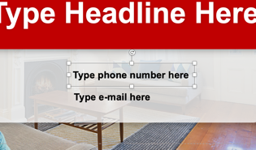
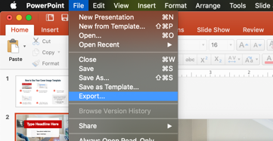
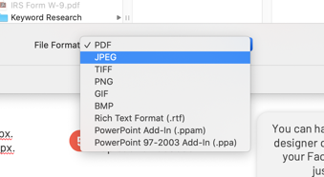
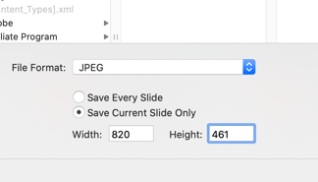
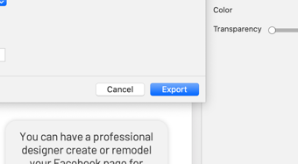
How to Use Your Cover Image Template
1
Enter your info into the template.
2
Go to the File menu and click “Export.”
3
Set the File Type option to JPEG.
You can have a professional designer create or remodel your Facebook page for
just $49.95.
Call 904-549-7616
for details.
Set width to 820 px. Set height to 461 px.
Click ”Export” and upload to Facebook.
4
5

Slide 2

Type Headline Here
Type Phone Here ● Type Email Here

Slide 3

Type Name Here
Type phone number here
Type e-mail here

Slide 4

Type Headline Here
Type Phone Here Type Email Here

Slide 5
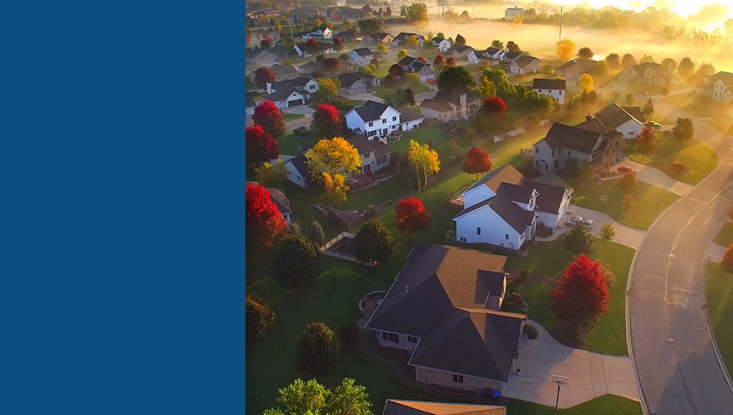
Name
Here
Type Phone Here
Type Email Here

Slide 6



Thanks For Being a Member of
Directory Pro
Be sure to check in each month for new downloads available exclusively for Pro members of the
Real Estate Agent Directory.
You can have a professional designer create or remodel your Facebook page for just $49.95.
Call (904) 549-7616.

